Slide 1
COMP3074 Mobile App Development I
Week 2

Slide 2
This week
Intents,
Resources
Building UI in Android
Layouts and Views
Unit tests

Slide 3
Creating Intents with Action and Data
Intent objects are composed of two main parts:
the action to be performed
the data to be acted upon
You can also specify action/data pairs using Intent Action types and Uri objects
The most common action types are defined in the Intent class, including ACTION_MAIN (describes the main entry point of an Activity) and ACTION_EDIT (used in conjunction with a Uri to the data edited)

Slide 4
Launching an Activity Belonging to Another Application
Here is an example of how to create a simple Intent with a predefined Action (ACTION_DIAL) to launch the Phone Dialer with a specific phone number to dial in the form of a simple Uri object:
Uri number = Uri.parse(“tel:5555551212”);
Intent dial = new Intent(Intent.ACTION_DIAL, number);
startActivity(dial);

Slide 5
How to Launch another Activity
Let’s see how can we launch another activity.
Build an application with a TextView and a Button. LAB/Assignment. Call the app SecondActivity
If you click on the button, it launches new activity.
Your App must have two activities.
Here!!
Notes:
SecondActivity – 3 Marks lab.

Slide 6
Setting Simple Resource Values
You can define resource types by editing resource XML files manually or by using resource editors available in Android Studio.
Here is a view of /res/values/strings.xml file:
<?xml version="1.0" encoding="utf-8"?>
<resources>
<string name="hello">Using Android Resources</string>
<string name="display">Demonstrating Font and Color!</string>
<string name="app_name">Simple Resource Example</string>
<color name="prettyTextColor">#fa31ff</color>
<dimen name="textPointSize">14pt</dimen>
<drawable name="redDrawable">#ff0000</drawable>
</resources>

Slide 7
Setting Simple Resource Values
You can create:
A String resource named hello with a value of “Using Android Resources”
A String resource named display with a value of “Demonstrating Font and Color!”
A color resource named prettyTextColor with a value of #ff0000
A dimension resource named textPointSize with a value of 14pt
A drawable resource named redDrawable with a value of #F00

Slide 8
Setting Simple Resource Values
The generated R.java file:
package test.simpleresources;
public final class R {
public static final class attr {
}
public static final class color {
public static final int prettyTextColor=0x7f050000;
}
public static final class dimen {
public static final int textPointSize=0x7f060000;
}
public static final class drawable {
public static final int icon=0x7f020000;
public static final int redDrawable=0x7f020001;
}
public static final class layout {
public static final int main=0x7f030000;
}
public static final class string {
public static final int app_name=0x7f040001;
public static final int hello=0x7f040000;
}
}

Slide 9
Accessing resources from Java code
package test.simpleresources;
import android.app.Activity;
import android.graphics.drawable.ColorDrawable;
import android.os.Bundle;
import android.widget.ImageView;
import android.widget.TextView;
public class SimpleResource extends Activity {
/** Called when the activity is first created. */
@Override
public void onCreate(Bundle savedInstanceState) {
super.onCreate(savedInstanceState);
setContentView(R.layout.main);

Slide 10
Accessing resources from Java code
String myString = getResources().getString(R.string.display);
int myColor = getResources().getColor(R.color.prettyTextColor);
float myDimen = getResources().getDimension(R.dimen.textPointSize);
ColorDrawable myDraw = (ColorDrawable)getResources().getDrawable(R.drawable.redDrawable);
ImageView imgView = (ImageView)findViewById(R.id.imageView1);
imgView.setImageDrawable(myDraw);
//String[] flavors = getResources().getStringArray(R.array.flavors);
TextView tv = (TextView)findViewById(R.id.txtView);
tv.setTextSize(myDimen);
tv.setTextColor(myColor);
tv.setText(myString);
}
}

Slide 11
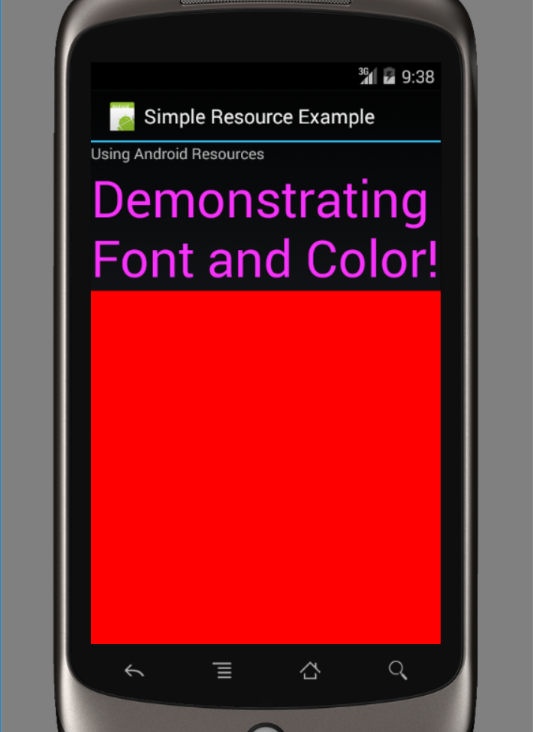
Simple Resources example

Slide 12


QUESTIONS

Slide 13
Defining String Arrays
String arrays, may be added to resource files by editing them manually:
<?xml version="1.0" encoding="utf-8"?>
<resources>
<string name="hello">Hello World, SimpleResource!</string>
<string name="app_name">Simple Resource Example</string>
<color name="prettyTextColor">#ff0000</color>
<dimen name="textPointSize">14pt</dimen>
<drawable name="redDrawable">#F00</drawable>
<string-array name=”flavors”>
<item>Vanilla</item>
<item>Chocolate</item>
<item>Strawberry</item>
</string-array>
</resources>
Access the array in your code:
String[] aFlavors = getResources().getStringArray(R.array.flavors);

Slide 14
Working with Resources
It is a common practice to store different types of resources in different files.
For example, store:
the strings in /res/values/strings.xml
the prettyTextColor color resource in /res/values/colors.xml
the textPointSize dimension resource in /res/values/dimens.xml
This does not change the names of the resources, nor the code used earlier to access the resources programmatically

Slide 15
Working with Colors
Android applications can store RGB color values, which can then be applied to other screen elements
The following color formats are supported:
#RGB (example, #F00 is 12-bit color, red)
#ARGB (example, #8F00 is 12-bit color, red with alpha 50%)
#RRGGBB (example, #FF00FF is 24-bit color, magenta)
#AARRGGBB (example, #80FF00FF is 24-bit color, magenta with alpha 50%)
Color values are tagged with the <color> tag and represent a name-value pair:
<resources>
<color name=”background_color”>#006400</color>
<color name=”text_color”>#FFE4C4</color>
</resources>
The following code retrieves a color resource called prettyTextColor:
int myResourceColor = getResources().getColor(R.color.prettyTextColor);

Slide 16
Working with Simple Drawables
Simple paintable drawable resources are defined in XML under the /res/values project directory and compiled into the application package at build time.
Paintable drawable resources use the <drawable> tag and represent a name-value pair.
Here’s an example of a simple drawable resource file /res/values/drawables.xml:
<resources>
<drawable name=”red_rect”>#F00</drawable>
</resources>
Drawable resources defined with <drawable> are simply rectangles of a given color:
ColorDrawable myDraw = (ColorDrawable)getResources().
getDrawable(R.drawable.redDrawable);

Slide 17
Using Image Resources Programmatically
Images resources are simply another kind of Drawable called a BitmapDrawable
Use resource ID of the image to set as an attribute on a user interface control:
ImageView flagImageView =
(ImageView)findViewById(R.id.ImageView01);
flagImageView.setImageResource(R.drawable.flag);
You can access the BitmapDrawable object directly:
BitmapDrawable bitmapFlag = (BitmapDrawable)
getResources().getDrawable(R.drawable.flag);

Slide 18
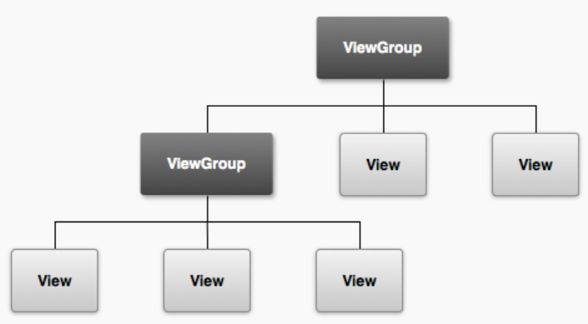
Android Views
android.view package contains a number of interfaces and classes related to drawing on the screen.
android.view.View class is the basic user interface building block within Android.
It represents a rectangular portion of the screen.
The View class serves as the base class for nearly all the user interface controls and layouts within the Android SDK:

Slide 19
Creating Layouts Using XML Resources
Layouts and user interface controls can be defined as application resources or created programmatically at runtime
Android provides a simple way to create layout files in XML as resources provided in the /res/layout project directory
This is the most common way

Slide 20
Creating Layouts Using XML Resources
You can configure almost any ViewGroup or View (or View subclass) attribute using the XML layout resource files
LinearLayout is the default layout file provided with any new Android project in Android Studio, referred to as /res/layout/main.xml: -- Not anymore, the new ones is RelatvieLayout
<?xml version=”1.0” encoding=”utf-8”?>
<LinearLayout xmlns:android=
“http://schemas.android.com/apk/res/android”
android:orientation=”vertical”
android:layout_width=”fill_parent”
android:layout_height=”fill_parent” >
<TextView
android:layout_width=”fill_parent”
android:layout_height=”wrap_content”
android:text=”@string/hello” />
</LinearLayout>

Slide 21
Creating Layouts Using XML Resources
LinearLayout is a ViewGroup that shows each child View either in a single column or in a single row.
When applied to a full screen, each child View is drawn under the previous View if the orientation is set to vertical or to the right of the previous View if orientation is set to horizontal
To associate the activity_main.xml layout with the activity, use the method call setContentView() with the identifier of the activity_main.xml layout.
The ID of the layout matches the XML filename without the extension:
setContentView(R.layout.activity_main);
Notes:
Cover layouts in details next week.

Slide 22
Creating Layouts Programmatically
You can create user interface components such as layouts at runtime programmatically:
public void onCreate(Bundle savedInstanceState) {
super.onCreate(savedInstanceState);
TextView text1 = new TextView(this);
text1.setText(“Hi there!”);
TextView text2 = new TextView(this);
text2.setText(“I’m second. I need to wrap.”);
text2.setTextSize((float) 60);
LinearLayout ll = new LinearLayout(this);
ll.setOrientation(LinearLayout.VERTICAL);
ll.addView(text1);
ll.addView(text2);
setContentView(ll);
}
Notes:
LAB: Max. 5 Marks.
Let’s get the code from Week 3 Text: “Add TextView programmatically:” and run the app!.
Change the Layout from Linear to Relative.
Add ImageView programmatically to the RelativeLayout in similar way to the TextView.
Use an image in the drawable folder different than the home screen image.
Verify the image is added to the bottom of the screen.
Set the screen background color to light green.
HelloWorld2.

Slide 23
Creating Layouts Programmatically
<?xml version=”1.0” encoding=”utf-8”?>
<LinearLayout xmlns:android=
“http://schemas.android.com/apk/res/android”
android:orientation=”vertical”
android:layout_width=”fill_parent”
android:layout_height=”fill_parent”
>
<TextView
android:id=”@+id/TextView1”
android:layout_width=”fill_parent”
android:layout_height=”wrap_content”
android:text=”Hi There!”
/>
<TextView
android:id=”@+id/TextView2”
android:layout_width=”fill_parent”
android:layout_height=”wrap_content”
android:textSize=”60px”
android:text=”I’m second. I need to wrap.”
/>
</LinearLayout>

Slide 24
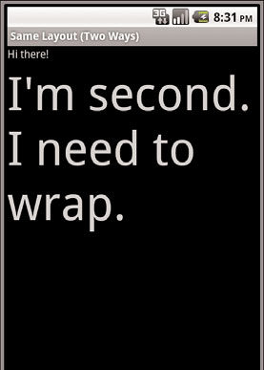
Creating Layouts Programmatically
If the layout resource is stored in the /res/layout/resource_based_layout.xml file, that is
setContentView(R.layout.resource_based_layout);
Two different methods to create a screen have the same result
Notes:
When to name the layout file ?

Slide 25
Organizing Your User Interface
You add child View objects to a ViewGroup programmatically using the method addView().
In XML, you add child objects to a ViewGroup by defining the child View control as a child node in the XML
ViewGroup subclasses are broken down into two categories:
Layout classes
View container controls
Notes:
We saw the example ll.addView(text1); & ll.addView(text2);

Slide 26
Android Controls
android.widget contains Android controls
The Android SDK includes classes to draw most common objects, including ImageView, FrameLayout, EditText, and Button classes.
All controls are typically derived from the View class

Slide 27
Displaying Text to Users with TextView
TextView control is used to draw text on the screen.
You primarily use it to display fixed text strings or labels
It is derived from View and is within the android.widget package:
all the standard attributes such as width, height, padding, and visibility can be applied to the object
You can set the android:text property of the TextView to be either a raw text string in the layout file or a reference to a string resource.

Slide 28
Displaying Text to Users with TextView
<TextView android:id=”@+id/TextView01”
android:layout_width=”wrap_content”
android:layout_height=”wrap_content”
android:text=”Some sample text here” />
<TextView android:id=”@+id/TextView02”
android:layout_width=”wrap_content”
android:layout_height=”wrap_content”
android:text=”@string/sample_text” />

Slide 29
Displaying Text to Users with TextView
Call setContentView() method with the layout resource identifier to display this TextView on the screen
displayTextView = (TextView) findViewById(R.id.TextView01);
You can change the text displayed programmatically by calling the setText() method on the TextView object.
Retrieving the text is done with the getText() method.

Slide 30
Retrieving Data from Users
Two frequently used controls to handle this type of job are EditText controls and Spinner controls
EditText handles text input from a user.
The EditText class is derived from TextView
This is how to define an EditText control in an XML layout file:
<EditText
android:id=”@+id/EditText01”
android:layout_height=”wrap_content”
android:hint=”type here”
android:lines=”4”
android:layout_width=”fill_parent” />
hint attribute gives a hint to the user as to what should be typed in EditText control
lines attribute, which defines how many lines tall the input box is

Slide 31
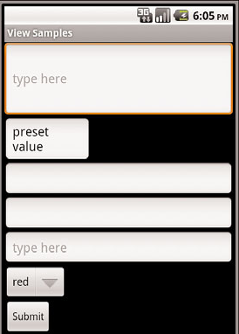
Retrieving Data from Users
To highlight a portion of the text from code use setSelection() method, and a call to selectAll() highlights the entire text entry field.
EditText object is essentially an editable TextView.
This means that you can read text from it in the same way as you did with TextView: by using the getText() method.
You can also set initial text to draw in the text entry area using the setText() method

Slide 32
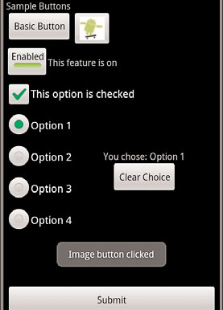
Using Buttons
The android.widget.Button class provides a basic button implementation in the Android SDK.
Within the XML layout resources, buttons are specified using the Button element.
The primary attribute for a basic button is the text field
Use basic Button controls for buttons with text such as “Ok,”“Cancel,” or “Submit.”
Notes:
Radio buttons vs. checkboxes.

Slide 33
Using Buttons
The following XML layout resource file shows a typical Button control definition:
<Button
android:id=”@+id/basic_button”
android:layout_width=”wrap_content”
android:layout_height=”wrap_content”
android:text=”Basic Button” />
Here is an example of some code that handles a click for a basic button and displays a Toast message on the screen:
setContentView(R.layout.buttons);
final Button basic_button = (Button) findViewById(R.id.basic_button);
basic_button.setOnClickListener(new View.OnClickListener() {
public void onClick(View v) {
Toast.makeText(ButtonsActivity.this,
“Button clicked”, Toast.LENGTH_SHORT).show();
}
});

Slide 34
Layout classes
LinearLayout
RelativeLayout
TableLayout
FrameLayout
We could have used an AbsoluteLayout to specify the exact x/y coordinate locations of each control on the screen instead, but this is not easily portable across many screen resolutions
http://www.tutorialspoint.com/android/android_absolute_layout.htm

Slide 35
Using Built-In Layout Classes
All layouts, regardless of their type, have basic layout attributes:
android:layout_attribute_name=”value”
Common attributes include the size attributes and margin attributes

Slide 36
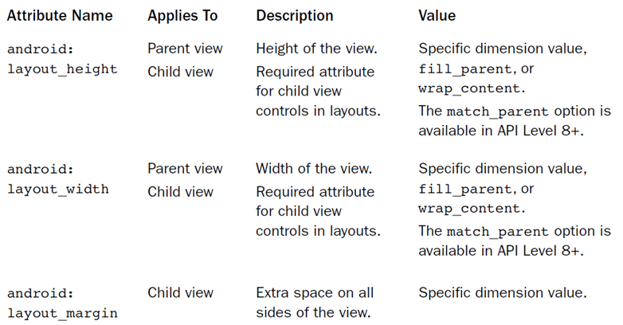
ViewGroup Attributes

Slide 37
ViewGroup Attributes
This example of a LinearLayout sets the size of the screen, containing one TextView that is set to its full height and the width of the LinearLayout (and therefore the screen):
<LinearLayout xmlns:android=
“http://schemas.android.com/apk/res/android”
android:layout_width=”fill_parent”
android:layout_height=”fill_parent”>
<TextView
android:id=”@+id/TextView01”
android:layout_height=”fill_parent”
android:layout_width=”fill_parent” />
</LinearLayout>
Notes:
LinearLayoutExample from Week 4.

Slide 38
ViewGroup Attributes
Here is an example of a Button object with some margins set via XML used in a layout resource file:
<Button
android:id=”@+id/Button01”
android:layout_width=”wrap_content”
android:layout_height=”wrap_content”
android:text=”Press Me”
android:layout_marginRight=”20px”
android:layout_marginTop=”60px” />

Slide 39
Using FrameLayout
FrameLayout view is designed to display a stack of child View items.
You can add multiple views to this layout, but each View is drawn from the top-left corner of the layout.
Use this to show multiple images within the same region, and the layout is sized to the largest child View in the stack.

Slide 40
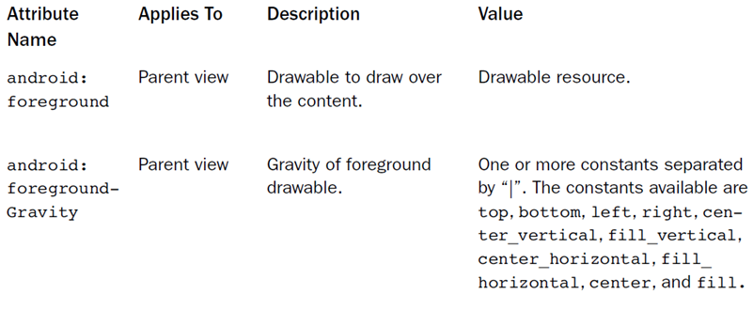
Using FrameLayout

Slide 41
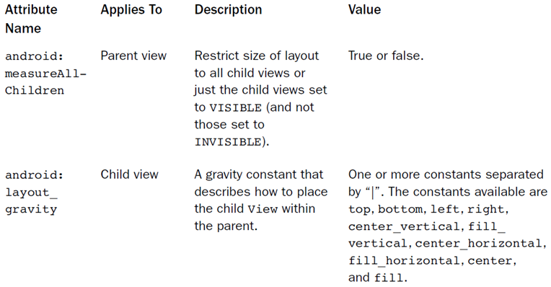
Using FrameLayout

Slide 42
Using FrameLayout
Here’s an example of an XML layout resource with a FrameLayout and two child View objects, both ImageView objects.
The green rectangle is drawn first and the red oval is drawn on top of it.
The green rectangle is larger, so it defines the bounds of the FrameLayout:
<FrameLayout xmlns:android=
“http://schemas.android.com/apk/res/android”
android:id=”@+id/FrameLayout01”
android:layout_width=”wrap_content”
android:layout_height=”wrap_content”
android:layout_gravity=”center”>

Slide 43
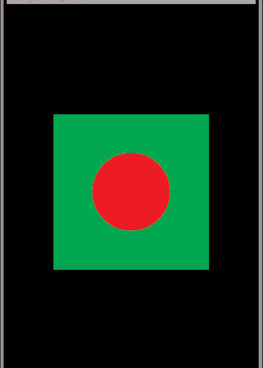
Using FrameLayout
<ImageView
android:id=”@+id/ImageView01”
android:layout_width=”wrap_content”
android:layout_height=”wrap_content”
android:src=”@drawable/green_rect”
android:minHeight=”200px”
android:minWidth=”200px” />
<ImageView
android:id=”@+id/ImageView02”
android:layout_width=”wrap_content”
android:layout_height=”wrap_content”
android:src=”@drawable/red_oval”
android:minHeight=”100px”
android:minWidth=”100px”
android:layout_gravity=”center” />
</FrameLayout>
Notes:
FrameLayout Example Get it from Week 4 FrameLayout Example – How to fix issues and then how to have the Red Oval in the centre of the green image.
Why the problem with png file ? They were not originally in PNG, change to jpg.

Slide 44
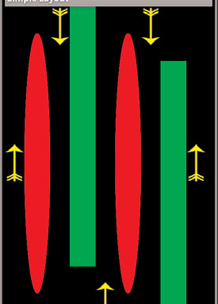
Using LinearLayout
A LinearLayout view organizes its child View objects in a single row, or column, depending on whether its orientation attribute is set to horizontal or vertical.
Very handy layout method for creating forms

Slide 45
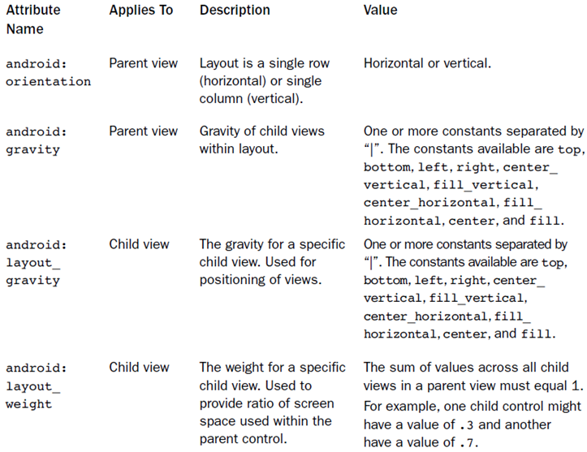
Using LinearLayout

Slide 46
Using RelativeLayout/ConstraintLayout
The RelativeLayout view enables you to specify where the child view controls are in relation to each other. Default Layout in Android Studio.
For instance, you can set a child View to be positioned “above” or “below” or “to the left of ” or “to the right of ” another View, referred to by its unique identifier.
You can also align child View objects relative to one another or the parent layout edges.

Slide 47
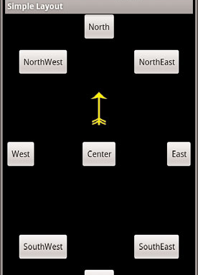
Using RelativeLayout
Combining RelativeLayout attributes can simplify creating interesting user interfaces without resorting to multiple layout groups to achieve a desired effect.
The picture shows how each of the button controls is relative to each other

Slide 48
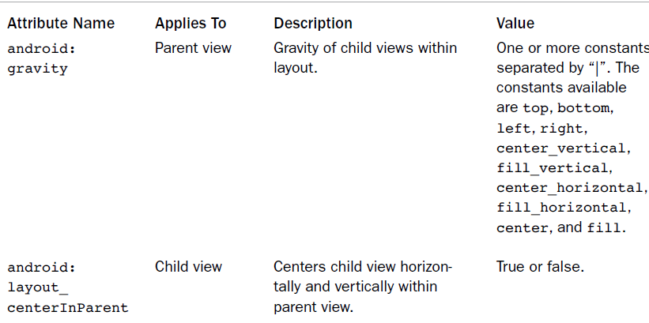
Using RelativeLayout

Slide 49
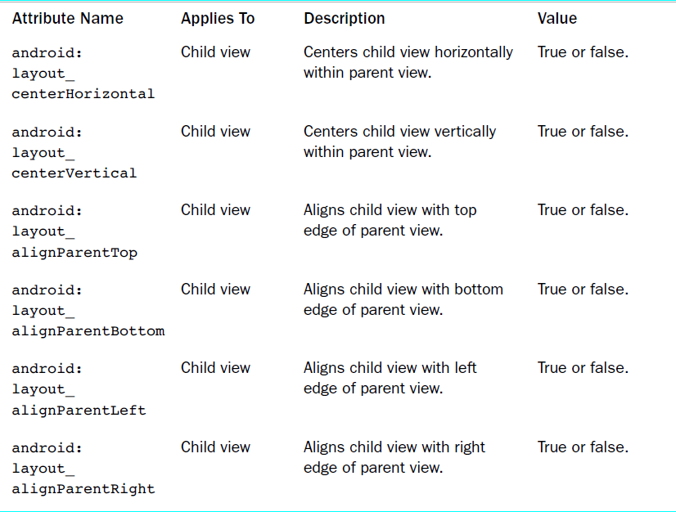
Using RelativeLayout

Slide 50
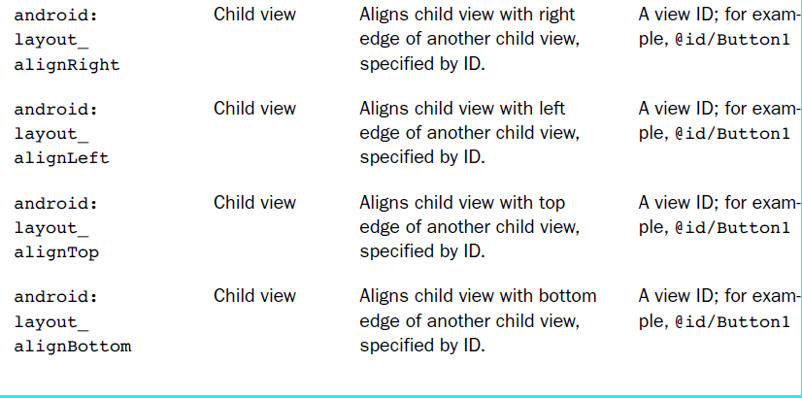
Using RelativeLayout

Slide 51
Using RelativeLayout
Here’s an example of an XML layout resource with a RelativeLayout and two child View objects, a Button object aligned relative to its parent, and an ImageView aligned and positioned relative to the Button (and the parent):
<?xml version=”1.0” encoding=”utf-8”?>
<RelativeLayout xmlns:android=
“http://schemas.android.com/apk/res/android”
android:id=”@+id/RelativeLayout01”
android:layout_height=”fill_parent”
android:layout_width=”fill_parent”>
<Button
android:id=”@+id/ButtonCenter”
android:text=”Center”
android:layout_width=”wrap_content”
android:layout_height=”wrap_content”
android:layout_centerInParent=”true” />
<ImageView
android:id=”@+id/ImageView01”
android:layout_width=”wrap_content”
android:layout_height=”wrap_content”
android:layout_above=”@id/ButtonCenter”
android:layout_centerHorizontal=”true”
android:src=”@drawable/arrow” />
</RelativeLayout>
Notes:
Draw this Layout ? See app

Slide 52
http://schemas.android.com/apk/res/android
In XML, xmlns declares a Namespace. In fact, when you do:
<LinearLayout android:id> </LinearLayout> Instead of calling android:id, the xml will use http://schemas.android.com/apk/res/android:id to be unique.
Generally this page doesn't exist (it's a URI, not a URL), but sometimes it is a URL that explains the used namespace.
The namespace has pretty much the same usage as the package name in a Java application.
Notes:
Draw this Layout ?

Slide 53
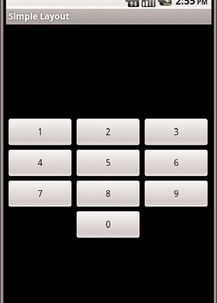
Using TableLayout
A TableLayout view organizes children into rows,
You add individual View objects within each row of the table using a TableRow layout View (which is basically a horizontally oriented LinearLayout) for each row of the table.
Because the contents of a TableLayout
are defined by rows as opposed to columns,
Android determines the number of columns
in the table by finding the row with the
most cells.

Slide 54
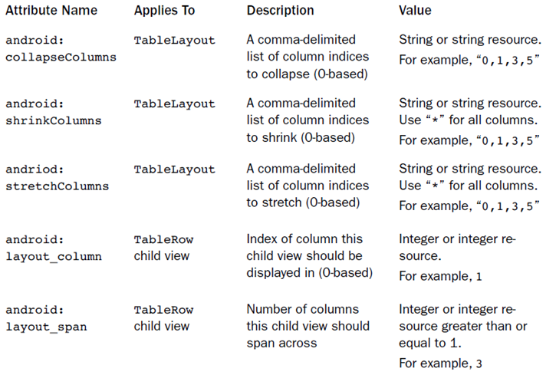
Using TableLayout

Slide 55
Using TableLayout
Here’s an example of an XML layout resource with a TableLayout with two rows (two TableRow child objects).
The TableLayout is set to stretch the columns to the size of the screen width.
The first TableRow has three columns; each cell has a Button object.
The second TableRow puts only one Button view into the second column explicitly:
<TableLayout xmlns:android=
“http://schemas.android.com/apk/res/android”
android:id=”@+id/TableLayout01”
android:layout_width=”fill_parent”
android:layout_height=”fill_parent”
android:stretchColumns=”*”>
<TableRow
android:id=”@+id/TableRow01”>
<Button
android:id=”@+id/ButtonLeft”
android:text=”Left Door” />
Notes:
android:stretchColumns="*" Then all columns will have the same size.

Slide 56
Using TableLayout
<Button
android:id=”@+id/ButtonMiddle”
android:text=”Middle Door” />
<Button
android:id=”@+id/ButtonRight”
android:text=”Right Door” />
</TableRow>
<TableRow
android:id=”@+id/TableRow02”>
<Button
android:id=”@+id/ButtonBack”
android:text=”Go Back”
android:layout_column=”1” />
</TableRow>
</TableLayout>
Notes:
Let’s get the example TableLayout from week 4

Slide 57
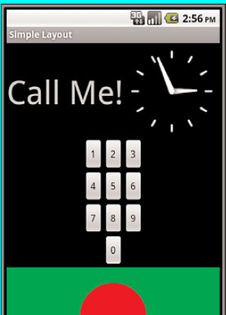
Using Multiple Layouts on a Screen
Combining different layout methods on a single screen can create complex layouts.
Because a layout contains View objects and is, itself, a View, it can contain other layouts.
The figure on the right demonstrates a combination of layout views used in conjunction to create a more complex and interesting screen

Slide 58
Using the App ToolBar
ToolBar was introduced in Android Lollipop, API 21 release and is the spiritual successor of the ActionBar. It's a ViewGroup that can be placed anywhere in your XML layouts. ToolBar's appearance and behavior can be more easily customized than the ActionBar.
https://guides.codepath.com/android/Using-the-App-ToolBar
Notes:
Check the menu in TableLayout Example – implemented in the link above.

Slide 59
Working with Menus
Menu resources are not tied to a specific control but can be reused in any menu control
Each menu resource is stored as a specially formatted XML files in the /res/menu directory
Here’s an example of a simple menu resource file /res/menu/speed.xml that defines a short menu with four items in a specific order:

Slide 60
Working with Menus
<?xml version="1.0" encoding="utf-8"?>
<menu xmlns:android="http://schemas.android.com/apk/res/android" >
<item
style="@style/menu_item_style"
android:id="@+id/start"
android:title="Start!"
android:orderInCategory="1"></item>
<item
style="@style/menu_item_style"
android:id="@+id/stop"
android:title="Stop!"
android:orderInCategory="4"></item>
<item
style="@style/menu_item_style"
android:id="@+id/accel"
android:title="Speed up!"
android:orderInCategory="2"></item>
<item
style="@style/menu_item_style"
android:id="@+id/decel"
android:title="Slow Down!"
android:orderInCategory="3"></item>
</menu>
Notes:
TableLayout Example

Slide 61
Working with Menus
You can use string resources for those titles, instead of typing in the strings:
<menu xmlns:android=
“http://schemas.android.com/apk/res/android”>
<item
android:id=”@+id/start”
android:title=”@string/start”
android:orderInCategory=”1”></item>
<item
android:id=”@+id/stop”
android:title=”@string/stop”
android:orderInCategory=”2”></item>
</menu>

Slide 62
Working with Menus
To access the preceding menu resource called /res/menu/speed.xml, simply override the method onCreateOptionsMenu() in your application:
public boolean onCreateOptionsMenu(Menu menu) {
getMenuInflater().inflate(R.menu.speed, menu);
return true;
}

Slide 63
Working with Menus
Handling the event when a menu option item is selected:
public boolean onOptionsItemSelected(MenuItem item)
{
switch (item.getItemId())
{
case R.id.start:
//displayTextView.setText("You selected start!");
Toast.makeText(this, "You selected start!", Toast.LENGTH_LONG).show();
break;
case R.id.accel:
Toast.makeText(this, "You selected speed up!", Toast.LENGTH_LONG).show();
break;
case R.id.stop: Toast.makeText(this, "You selected stop!", Toast.LENGTH_LONG).show();
break;
}
return true;
}
Notes:
Let’s add the menu and see how to handle selecting different menu options.
Let’s remove settings options.

Slide 64
Working with Menus- What you can control
There is the showAsAction option in the menu xml file that you can use to control how that single menu option will show up in the actionbar.
According to official menu resource doc the options are:
android:showAsAction=["ifRoom" | "never" | "withText" | "always" | "collapseActionView"]
The ifRoom flag only shows the option if there is enough room. This should be your first choice in most cases. This will however condense the title in the actionbar.
The never flag will have this option always in the overflow menu and never directly in the actionbar.
The use of the always flag will force the option to always appear in the acitonbar. Even if running on a very small screen size. This could render the title completely invisible.

Slide 65
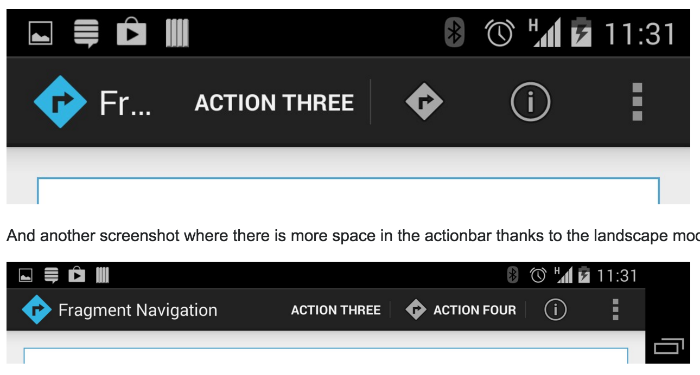
Working with Menus- What you can control
The collapseActionView: The action view associated with this action item (as declared by android:actionLayout or android:actionViewClass) is collapsible. Introduced in API Level 14.
A screenshot showing the menu, Portrait for Landscape.
Notes:
Let’s change Start to appear always
Let’s change Speed Up only shows the option if there is enough room

Slide 66
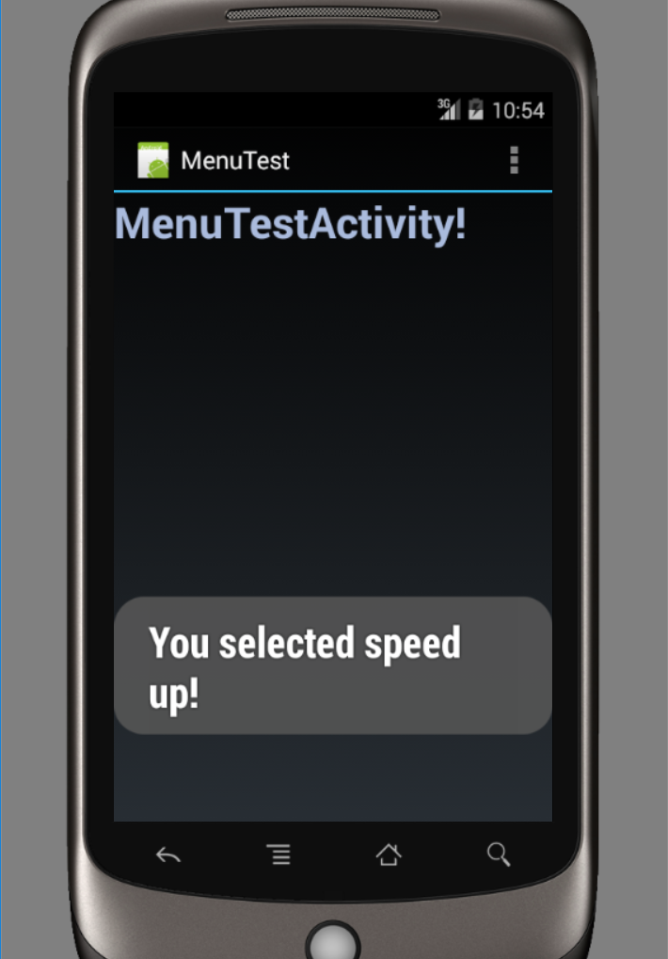
MenuTest example

Slide 67
Retrieving Data from Users
Constraining User Input with Input Filters:
Validating input after the user has entered something is one way to do this. However, a better way to avoid wasting the user’s time is to filter the input.
The EditText control provides a way to set an InputFilter that does only this
Here is an example of an EditText control with two built-in filters that might be appropriate for a two-letter state abbreviation:
final EditText text_filtered =
(EditText) findViewById(R.id.input_filtered);
text_filtered.setFilters(new InputFilter[] {
new InputFilter.AllCaps(),
new InputFilter.LengthFilter(2)
});

Slide 68
EditText Field
A text field allows the user to type text into your app. It can be either single line or multi-line. Touching a text field places the cursor and automatically displays the keyboard. In addition to typing, text fields allow for a variety of other activities, such as text selection (cut, copy, paste) and data look-up via auto-completion.
http://developer.android.com/guide/topics/ui/controls/text.html
LinearLayoutExample from Week 4
Notes:
LinearLayoutExample from Week 3.
LAB: when user click on Send, display values entered in the 3 EditText fields into Toast
Use b1.setOnClickListener(new View.OnClickListener() { to handle user click!.

Slide 69
Giving Users Input Choices Using Spinner Controls
Limit the choices available for users to type:
set the available choices in the layout definition by using the entries attribute with an array resource (specifically a string-array that is referenced as something such as @array/state-list):
Here is an example of the XML layout definition for a Spinner control for choosing a color:
<Spinner
android:id=”@+id/Spinner01”
android:layout_width=”wrap_content”
android:layout_height=”wrap_content”
android:entries=”@array/colors”
android:prompt=”@string/spin_prompt” />

Slide 70
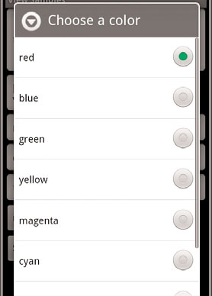
Giving Users Input Choices Using Spinner Controls
Retrieve the selected View and extract the text directly:
final Spinner spin = (Spinner) findViewById(R.id.Spinner01);
TextView text_sel = (TextView)spin. getSelectedView();
String selected_text = text_sel.getText();
Let’s do the Spinner Example, download the document Spinner Example from Week 4 and follow the steps.
Be careful when you copy and paste, pay attention to classes!.
Filtering choices with a spinner control
Notes:
Let’s do the Spinner Example, download the document Spinner Example from Week 4 and follow the steps.
Be careful when you copy and paste, pay attention to classes!.
Why the spinner prompt not displayed ?? Check android:prompt="@string/spinner_prompt" /> in activity_spinner.xml!

Slide 71
Using ImageButton
An ImageButton is, for most purposes, almost exactly like a basic button.
Click actions are handled in the same way.
The primary difference is that you can set its src attribute to be an image.
Here is an example of an ImageButton definition in an XML layout resource file:
<ImageButton
android:layout_width=”wrap_content”
android:layout_height=”wrap_content”
android:id=”@+id/image_button”
android:src=”@drawable/droid” />

Slide 72
Using Check Boxes
The Android check box contains a text attribute that appears to the side of the check box.
This is used in a similar way to the label of a basic button.
In fact, it’s basically a TextView next to the button.
Here’s an XML layout resource definition for a CheckBox control:
<CheckBox
android:id=”@+id/checkbox”
android:layout_width=”wrap_content”
android:layout_height=”wrap_content”
android:text=”Check me?” />

Slide 73
Using Check Boxes
The following example shows how to check for the state of the button programmatically and change the text label to reflect the change:
final CheckBox check_button = (CheckBox) findViewById(R.id.checkbox);
check_button.setOnClickListener(new View.OnClickListener() {
public void onClick (View v) {
TextView tv = (TextView)findViewById(R.id.checkbox);
tv.setText(check_button.isChecked() ?
“This option is checked” :
“This option is not checked”);
}
});

Slide 74
Toggle buttons
A Toggle Button is similar to a check box in behavior but is usually used to show or alter the on or off state of something. Like the CheckBox, it has a state (checked or not).
Unlike the CheckBox, it does not show text next to it. Instead, it has two text fields.
The first attribute is textOn, which is the text that displays on the button when its checked state is on.
The second attribute is textOff, which is the text that displays on the button when its checked state is off.

Slide 75
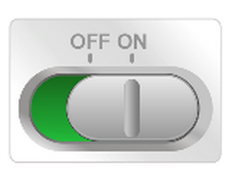
Toggle buttons
The following layout code shows a definition for a toggle button that shows “Enabled” or “Disabled” based on the state of the button:
<ToggleButton
android:id=”@+id/toggle_button”
android:layout_width=”wrap_content”
android:layout_height=”wrap_content”
android:text=”Toggle”
android:textOff=”OFF”
android:textOn=”ON” />

Slide 76
Toggle buttons
To detect when the user activates the button or switch, create an CompoundButton.OnCheckedChangeListenerobject and assign it to the button by calling setOnCheckedChangeListener(). For example:
ToggleButton toggle = (ToggleButton) findViewById(R.id.togglebutton); toggle.setOnCheckedChangeListener(new CompoundButton.OnCheckedChangeListener() { public void onCheckedChanged(CompoundButton buttonView, boolean isChecked) { if (isChecked) { // The toggle is enabled } else { // The toggle is disabled } } });

Slide 77
Using RadioGroups and RadioButtons
The RadioButton objects are similar to CheckBox objects.
They have a text label next to them, set via the text attribute, and they have a state (checked or unchecked)
However, you should group RadioButton objects inside a RadioGroup that handles enforcing their combined states so that only one RadioButton can be checked at a time.

Slide 78
Using RadioGroups and RadioButtons
Here we have an XML layout resource with a RadioGroup containing four RadioButton objects
The RadioButton objects have text labels,“Option 1,” and so on.
The XML layout resource definition is shown here:
<RadioGroup android:id=”@+id/RadioGroup01”
android:layout_width=”wrap_content”
android:layout_height=”wrap_content”>
<RadioButton
android:id=”@+id/RadioButton01”
android:layout_width=”wrap_content”
android:layout_height=”wrap_content”
android:text=”Option 1”>
</RadioButton>

Slide 79
Using RadioGroups and RadioButtons
<RadioButton android:id=”@+id/RadioButton02”
android:layout_width=”wrap_content”
android:layout_height=”wrap_content”
android:text=”Option 2”></RadioButton>
<RadioButton android:id=”@+id/RadioButton03”
android:layout_width=”wrap_content”
android:layout_height=”wrap_content”
android:text=”Option 3”></RadioButton>
<RadioButton android:id=”@+id/RadioButton04”
android:layout_width=”wrap_content”
android:layout_height=”wrap_content”
android:text=”Option 4”></RadioButton>
</RadioGroup>

Slide 80
Using RadioGroups and RadioButtons
You handle actions on these RadioButton objects through the RadioGroup object.
The following example shows registering for clicks on the RadioButton objects within the RadioGroup:

Slide 81
Using RadioGroups and RadioButtons
final RadioGroup group = (RadioGroup)findViewById(R.id.RadioGroup01);
final TextView tv = (TextView)
findViewById(R.id.TextView01);
group.setOnCheckedChangeListener(new
RadioGroup.OnCheckedChangeListener() {
public void onCheckedChanged(
RadioGroup group, int checkedId) {
if (checkedId != -1) {
RadioButton rb = (RadioButton)
findViewById(checkedId);
if (rb != null) {
tv.setText(“You chose: “ + rb.getText());
}
} else {
tv.setText(“Choose 1”);
}
}
});

Slide 82
Using RadioGroups and RadioButtons
The entire RadioGroup can be cleared so that none of the RadioButton objects are selected.
The following example demonstrates how to do this in response to a button click outside of the RadioGroup:
final Button clear_choice = (Button) findViewById(R.id.Button01);
clear_choice.setOnClickListener(new View.OnClickListener() {
public void onClick(View v) {
RadioGroup group = (RadioGroup)
findViewById(R.id.RadioGroup01);
if (group != null) {
group.clearCheck();
}
Notes:
Get the XML from Week 4 Text Radio Button
Add logic to the app to display Toast what radio button is selected.
Let’s see how we could do that – Get the text from Week 4 Text, Let’s add code to detect radio button selected!.
Build an application and change the checkbox text - UIExamples

Slide 83
References
Textbook
Android Documentation
https://developer.android.com/guide/components/fundamentals.html
http://developer.android.com/tools/studio/index.html
https://developer.android.com/training/basics/firstapp/creating-project.html

Slide 84
QUESTIONS

Slide 85
Orientation Detection
Get orientation programmatically
getResources().getConfiguration().orientation
Programmatically set screen orientation in Android
//set screen orientation of activity (landscape)
setRequestedOrientation(ActivityInfo.SCREEN_ORIENTATION_LANDSCAPE);
//set screen orientation of activity (portrait)
setRequestedOrientation(ActivityInfo.SCREEN_ORIENTATION_PORTRAIT);
Notes:
SecondActivity

Slide 86
Orientation Detection
Let’s get the project ScreenLayoutDetect from week 3 and run the app.
LAB: let’s detect orientation when run the app.
Notes:
SecondActivity

Slide 87
Debug Android Application
Android Studio includes a debugger that allows you to debug apps running on the Android Emulator or a connected Android device. With the Android Studio debugger, you can:
https://developer.android.com/studio/debug/index.html

Slide 88
References
Textbook
Android Documentation
https://developer.android.com/guide/components/fundamentals.html
http://developer.android.com/tools/studio/index.html
https://developer.android.com/training/basics/firstapp/creating-project.html

Slide 89
QUESTIONS

Slide 90

Software Testing

Slide 91
Ｗhat is Software Testing
Software testing is an activity to check whether the actual results match the expected results and to ensure that the software system is defect free. It involves execution of a software component or system component to evaluate one or more properties of interest.
TL;DR:
Check whether your implementation is matched the project goal or tasks.

Slide 92
Why testing is important
Testing is important because software bugs could be expensive or even dangerous. Software bugs can potentially cause monetary(money loss) and human loss, history is full of such examples:
Nissan cars have to recall over 1 million cars from the market due to software failure in the airbag sensory detectors. There has been reported two accident due to this software failure.
Starbucks was forced to close about 60 percent of stores in the U.S and Canada due to software failure in its POS system. At one point store served coffee for free as they unable to process the transaction.
Some of the Amazon’s third party retailers saw their product price is reduced to 1p due to a software glitch. They were left with heavy losses.
China Airlines Airbus A300 crashed due to a software bug on April 26, 1994, killing 264 innocent live
….
If Origami made user to loss money even we can refund but reputation, customer relationship, … all may loss.

Slide 93
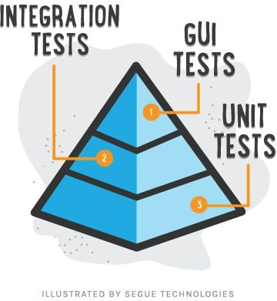

Software Testing Types
White Box Testing
Black Box Testing
Use Case Testing
Software performance testing
Pressure Testing
...
It’s Software Engineer’s duty
It’s QA’s duty

Slide 94
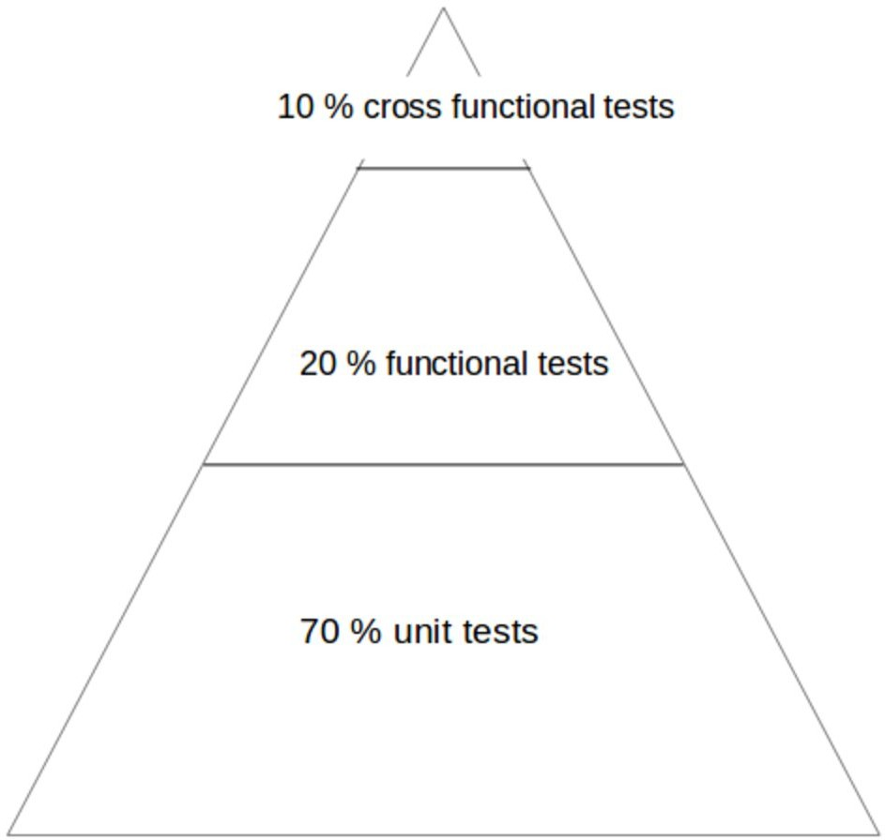

Slide 95
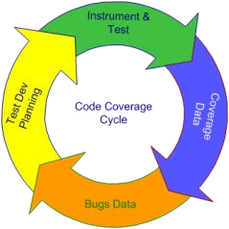
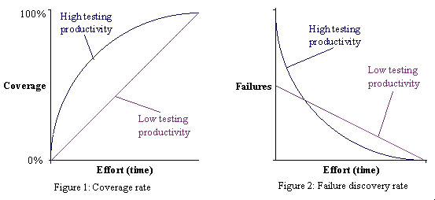
Testing Cycle

Slide 96
Software Testing is something we are not used to do, we feel it is troublesome, and it takes a lot of time.
But it is a part of Software Development and it is the most we need to be serious on.
Additionally, it can improve the code quality.

Slide 97
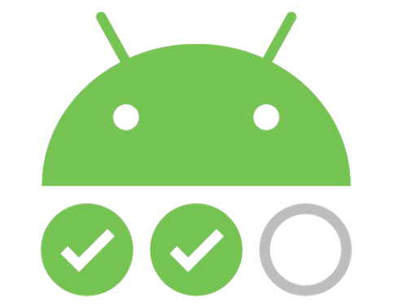
Android Test

Slide 98
Unit Testing
Def: A unit test should test a class in isolation. Side effects from other classes or the system should be eliminated if possible. To eliminate these side effects you have to replace dependencies to other classes. This can be done via using replacements for the real dependencies.
3 phases(Also known as Arrange, Act and Assert, or simply AAA.):
First, it initializes a small piece of an application it wants to test (also known as the system under test, or SUT)
then it applies some stimulus to the system under test (usually by calling a method on it)
finally, it observes the resulting behavior

Slide 99
What’s the good Unit Test
Easy to write
Readable
Reliable
Fast
Truly unit, not integration

Slide 100
Write testable code
SRP (Single Responsibility Principle)
IoC (Inversion of Control)
...
It is as same as we do modularize or OOP with Design Pattern. If you are used to those design principle you are writing testable code.

Slide 101

JUnit
JUnit is a unit testing framework for the Java programming language. JUnit has been important in the development of test-driven development, and is one of a family of unit testing frameworks which is collectively known as xUnit that originated with SUnit.

Slide 102
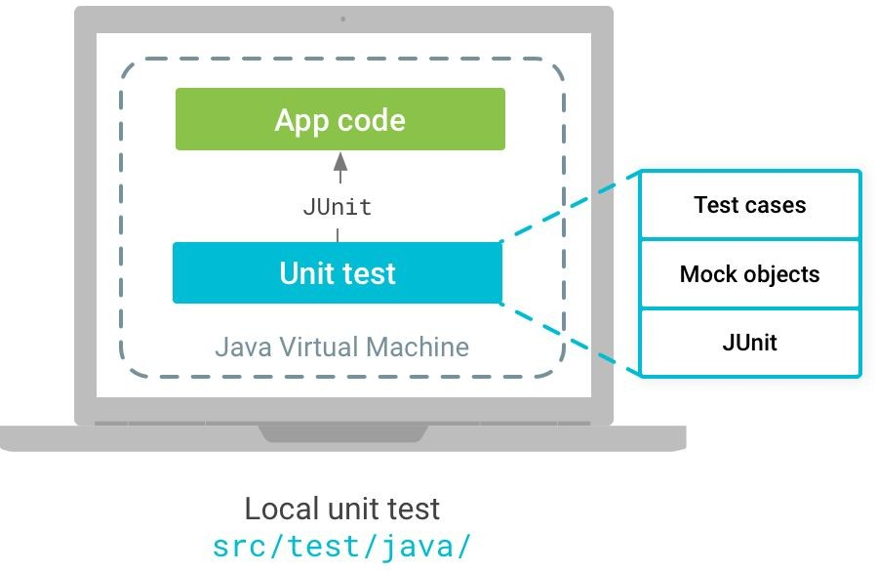
How do we use Unit Test on Android
Android tests are based on JUnit, and you can run them either as local unit tests on the JVM or as instrumented tests on an Android device.
Test types
Local unit tests In Android Studio,
Located at [module-name]/src/test/java/.
Instrumented tests (talk in next part)

Slide 103
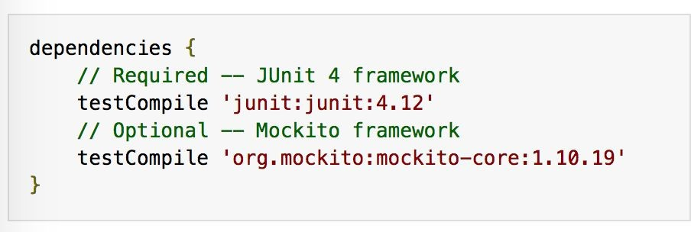
How do we use Unit Test on Android - JUnit
Set up the environment
Be careful of what build configuration you are using. If Unit Test, it should be ‘testCompile’, not ‘androidTestCompile’
Mock testing lib

Slide 104
How do we use Unit Test on Android - JUnit
Suppose now we want to test the class, EmailValidator.
We should make a test case as smallest as possible.
We should make the true and the false cases
Naming your UnitTest class with a postfix, ‘Test’
Naming your readable test case function.
Give a expectant result.
EmailValidator
+ isValidEmail(String) + ...

Slide 105
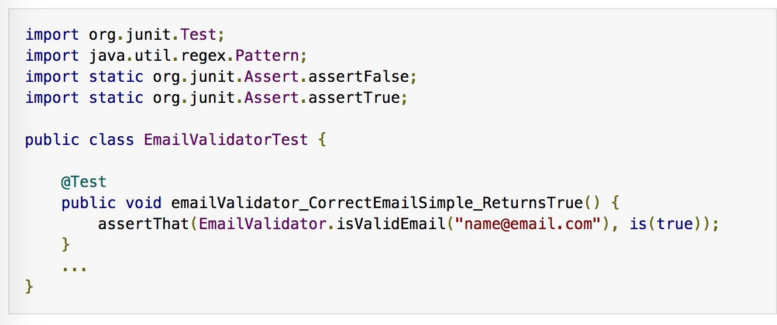
How do we use Unit Test on Android - JUnit
Real Result
Expectation

Slide 106
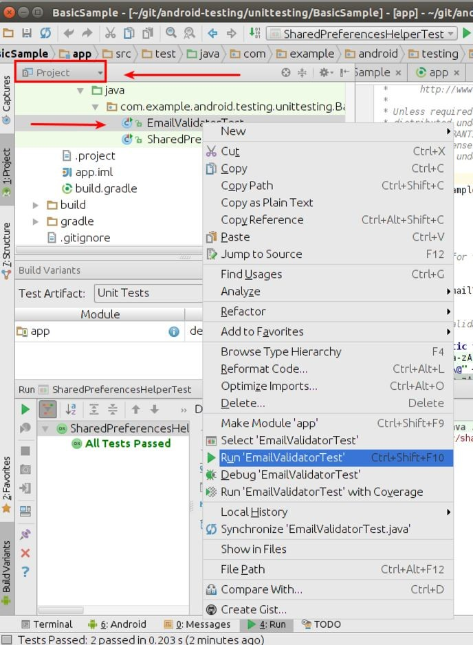
How do we use Unit Test on Android - JUnit
Run your JUnit Test

Slide 107
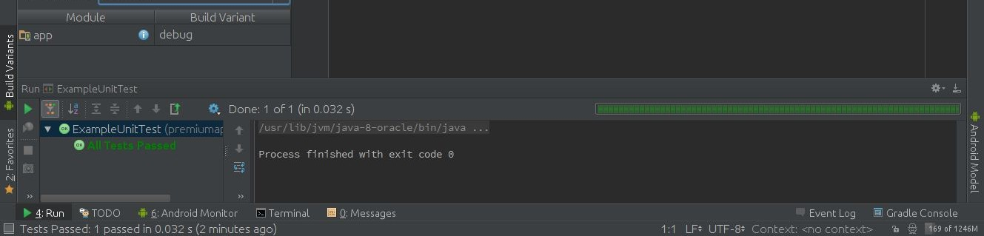
How do we use Unit Test on Android - JUnit
See the result.

Slide 108
How do we use Unit Test on Android - JUnit and Mock
Set up your environment
Add Mockito in your dependencies,
i.e., testCompile 'org.mockito:mockito-core:1.10.19'
Recommend use @RunWith(AndroidJUnitRunner.class) annotation as your test rule.

Slide 109
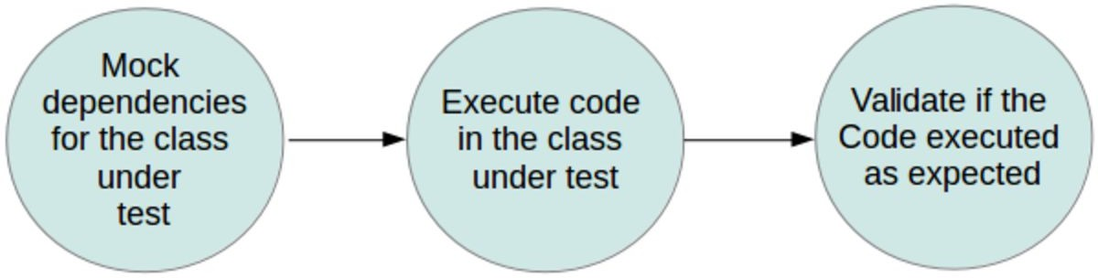
How do we use Unit Test on Android - JUnit and Mock
How it work:
Not talking about TDD or BDD
As Unit Test definition, ‘A unit test should test a class in isolation’

Slide 110
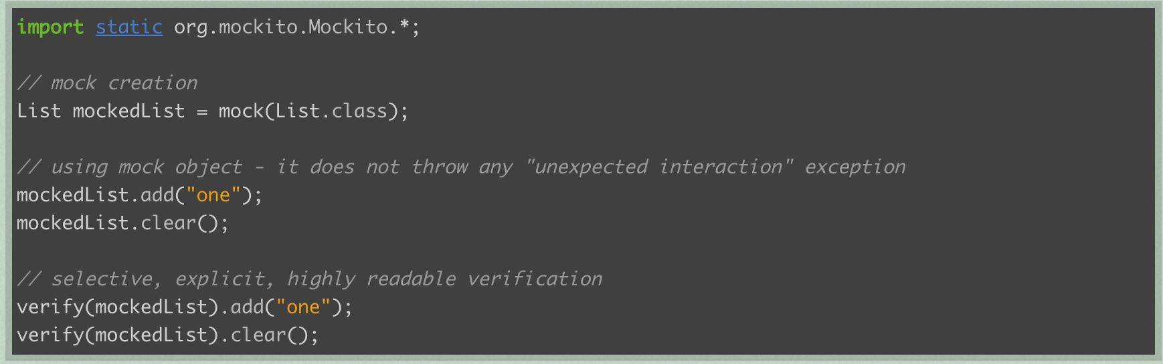
How do we use Unit Test on Android - JUnit and Mock

Slide 111
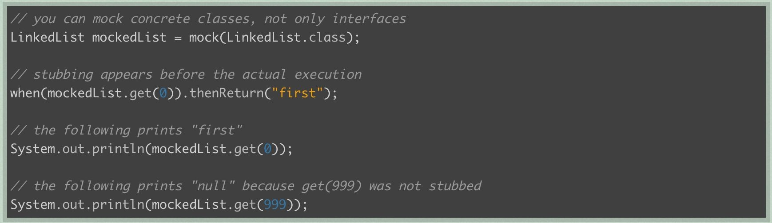
How do we use Unit Test on Android - JUnit and Mock

Slide 112
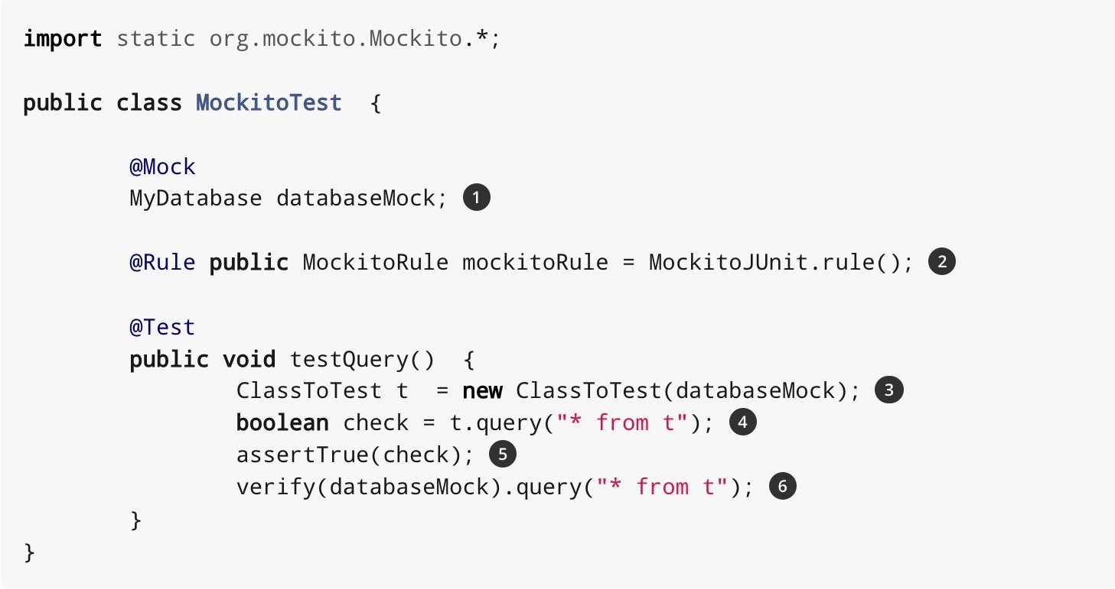
How do we use Unit Test on Android - JUnit and Mock

Slide 113
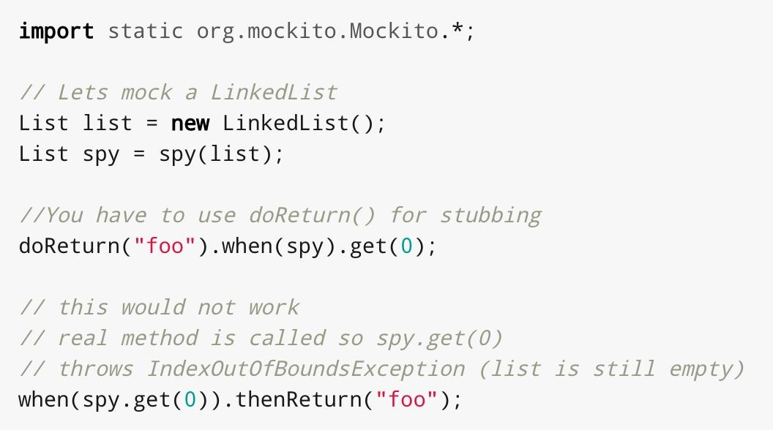
How do we use Unit Test on Android - JUnit and Mock
spy()/@Spy: partial mocking, real methods are invoked but still can be verified and stubbed

Slide 114
Case Studies
Origami
OrigamiAuthenticatedState
× | onCreated
× | onAuthenticated
× | onStop
× | tryLogin
AuthenticationApiClient
IAuthentication.
AuthenticationCallback

Slide 115
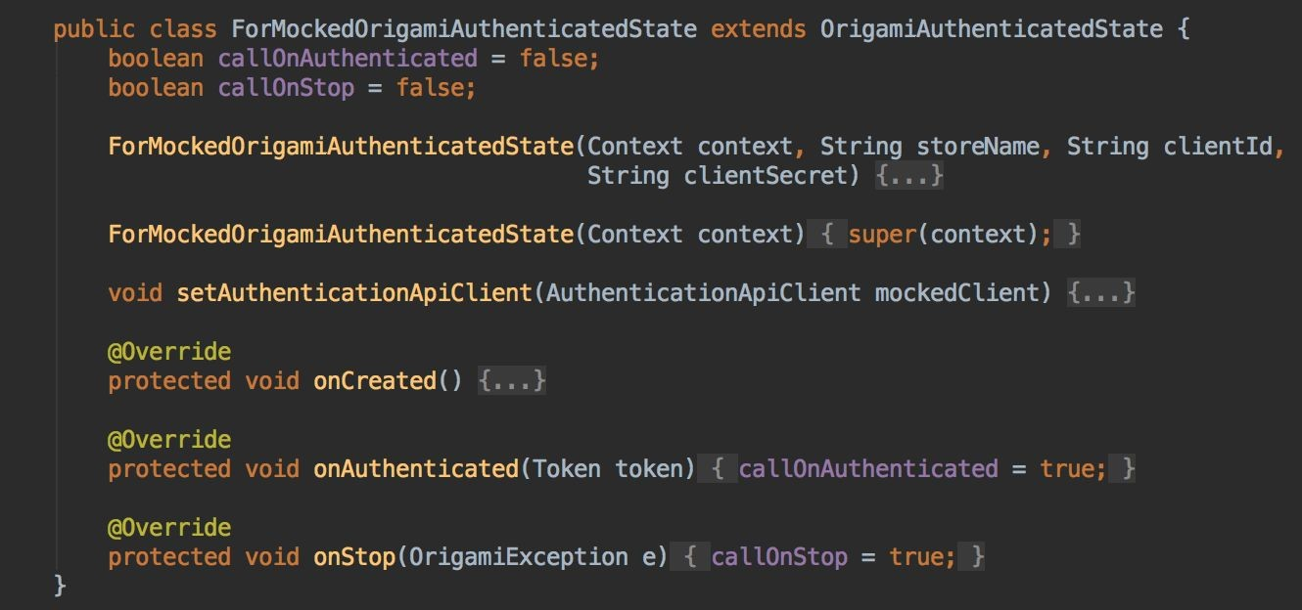
Case Studies
Protected Method

Slide 116
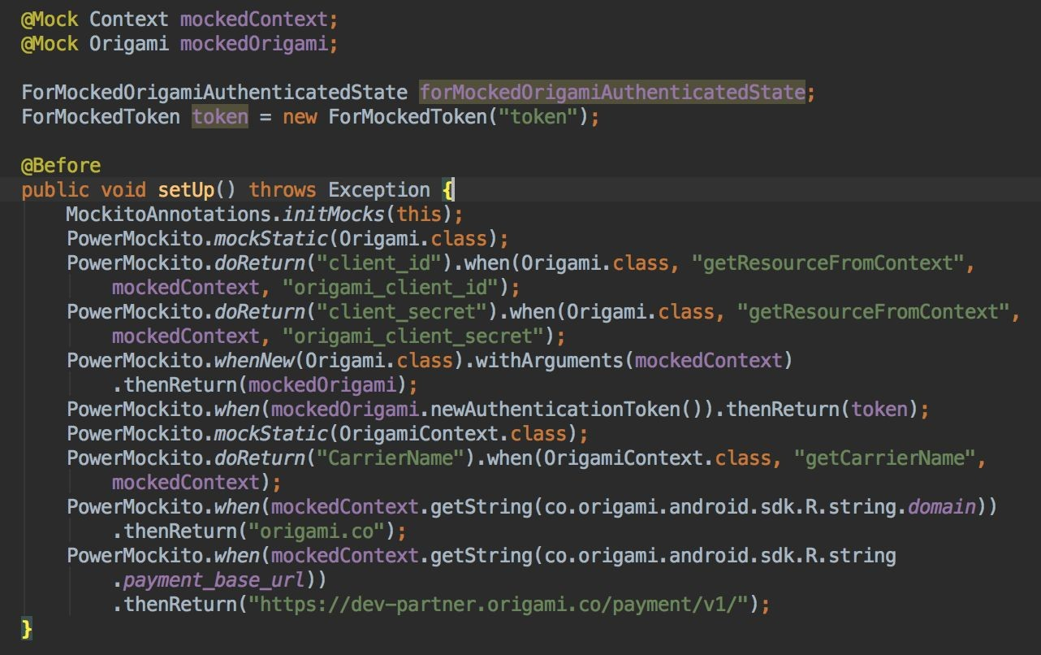
Case Studies
Package/Private Static Method

Slide 117
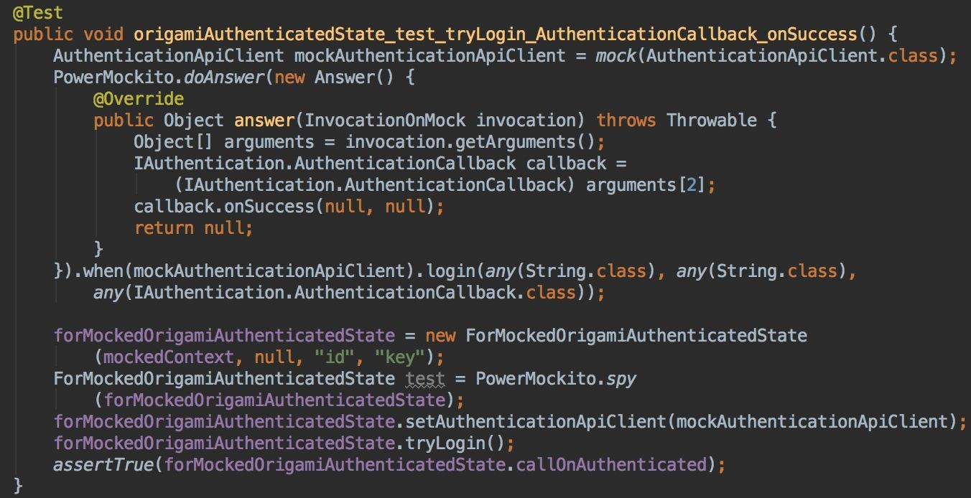
Case Studies
Asynchronous Function: OrigamiAuthenticatedState.tryLogin() -> AuthenticationApiClient.login -----> OrigamiAuthenticatedState.onAuthenticated()

Slide 118
Summary
Software Testing is to evaluate what you did match project or task goal.
Software Testing is also a part of Software Development and it’s coverted in Software Engineer’s duty.
Android Test Types: Local Unit Testing and Instruments Testing
Unit Test: Write testable code and good test code.
How to do Android Unit Test with Mock object.

Slide 119
Sharing
Google Test Blog: https://testing.googleblog.com/
Chiu-Ki Chan blog: http://blog.sqisland.com/
After being a software engineer for 6+ years at Google and 1.5 years at two startups, I now run my own mobile development company. https://developers.google.com/experts/people/chiu-ki-chan
How to be an Android Expert - Android Sumit 2015

Slide 120
References
http://www.guru99.com/software-testing-introduction-importance.html
Frustration-free Android Device Test:
https://m.signalvnoise.com/5-steps-to-creating-frustration-free-android-test-de vices-9bb2750edd19#.h6r7y2bgd
https://www.toptal.com/qa/how-to-write-testable-code-and-why-it-matters
https://testing.googleblog.com/
Do’s and Don’ts:
https://blog.mindorks.com/the-dos-and-don-ts-of-writing-test-cases-in-android- 70f1b5dab3e1#.jntarglw5
https://afourtech.com/devices-to-test-android-app/

Slide 121
QUESTIONS

Slide 122

Examples for lab

Slide 123
Intents Example
package test.samples;
import android.app.Activity;
import android.os.Bundle;
import android.content.Intent;
import android.net.Uri;
import android.view.View;
public class AndroidTestActivity extends Activity {
/** Called when the activity is first created. */
@Override
public void onCreate(Bundle savedInstanceState) {
super.onCreate(savedInstanceState);
setContentView(R.layout.main);
}

Slide 124
Intents Example
public void callIntent(View view) {
Intent intent = null;
switch (view.getId()) {
case R.id.Button01:
intent = new Intent(Intent.ACTION_VIEW,
Uri.parse("http://centennialcollege.ca"));
startActivity(intent);
break;
case R.id.Button02:
intent = new Intent(Intent.ACTION_CALL,
Uri.parse("tel:555555555"));
startActivity(intent);
break;
default:
break;
}
}
} // end of AndroidTestActivity
Notes:
Let’s extend the example and do the above.

Slide 125
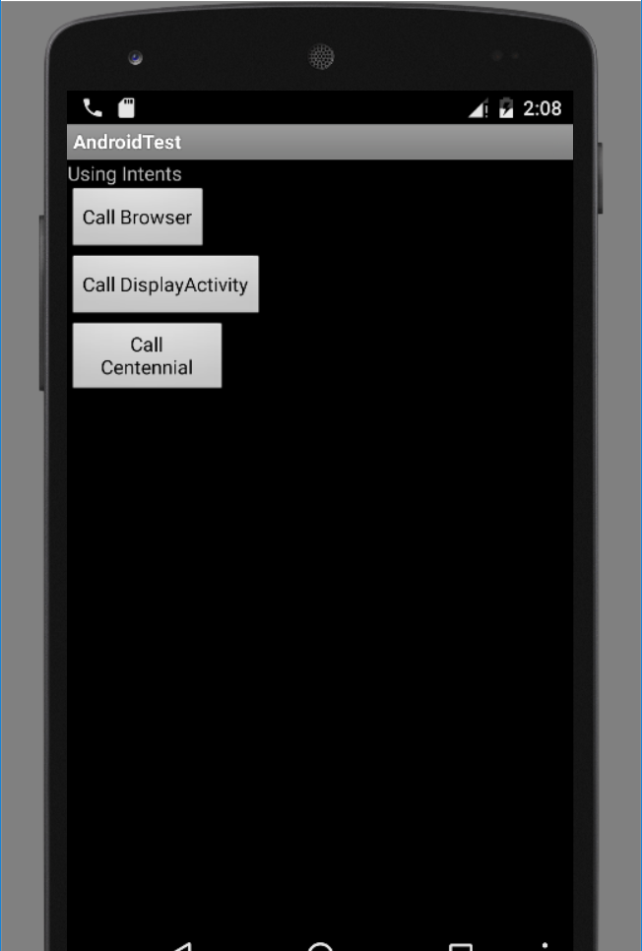
Intents Example

Slide 126

Intents Example

Slide 127
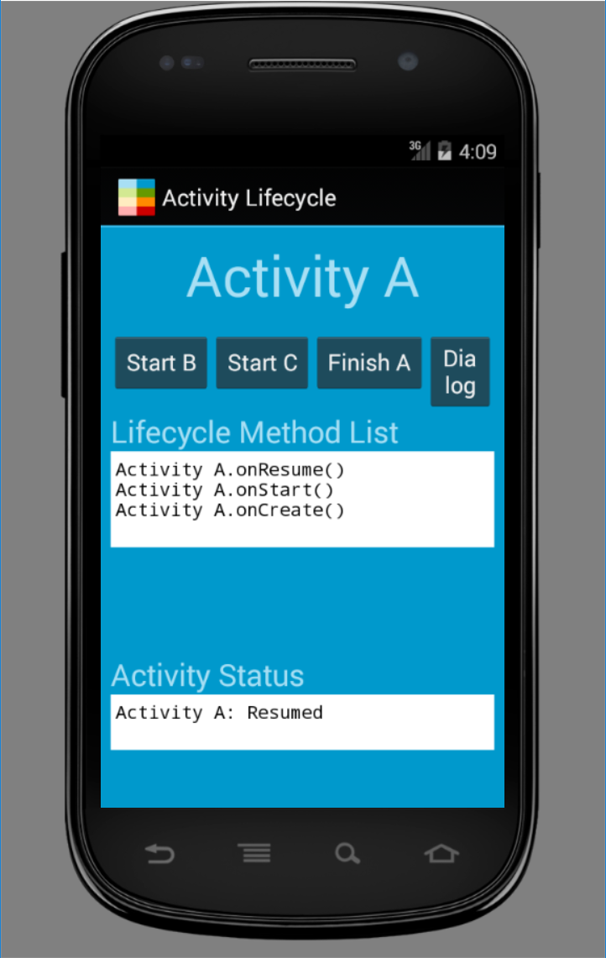
Activity Life Cycle example with Intents

Slide 128
Earlier Lab
What was the issue with
intent =new Intent((Intent.ACTION_CALL), Uri.parse("tel:(416) 880-5503")); startActivity(intent);
You added below into Manifest file:
<uses-permission android:name="android.permission.CALL_PHONE" />

